Slide 1


Institute for Roads, Streets and Infrastructures for Mobility (IDRRIM)
White Paper
"Maintaining and preserving
the transport infrastructure assets:
a requirement for France"
Marc TASSONE,
Managing Director

Slide 2
FOREWORD

Slide 3
> Roads : robustness and durability linked to the materials they are made of (stones, cement and bitumen)
But our infrastructures and the services they offer are not eternal :
> Functional qualities which decrease under the effects of weather and traffic
> Time scale of the infrastructure vs political and economic calendar
How guarantee their durable quality and performance by regular maintenance expenses, long life investment and reconstruction at end of cycle ?

Slide 4
Transport infrastructures : a particularly conducive field
to the "gray debt" or "invisible debt"
Saving on maintenance and delaying maintenance investment may look like keeping a good balanced budget
But the decline in the real value of the stock and the effects on the level of service will appear a few years later, requiring an investment 2 to 4 times higher to bring back its utility to the infrastructure
To meet these needs:
2012 : launch of the study "Management and Maintenance of Urban and Road Heritage: Methods, Tools and Techniques" (GEPUR)
2014 : Publication of the IDRRIM’s White Paper to sensitize policy makers (state and local elected officials) on the need to maintain and preserve the public heritage

Slide 5
TRANSPORT INFRASTRUCTURE : backbone of ECONOMY
1

Slide 6
Maintaining the quality and performance of the transportation system : a key issue for a nation and its economy
> A public heritage, guarantee growth and attractiveness
> The quality of French transport infrastructure (road, rail, port and airport) : 2nd place in Europe and 3rd in the world in terms of attractiveness for foreign companies wishing to set up outside their own country
> France's attractiveness for foreign direct investment: 3rd world behind the US and China (Hong Kong included).

Slide 7
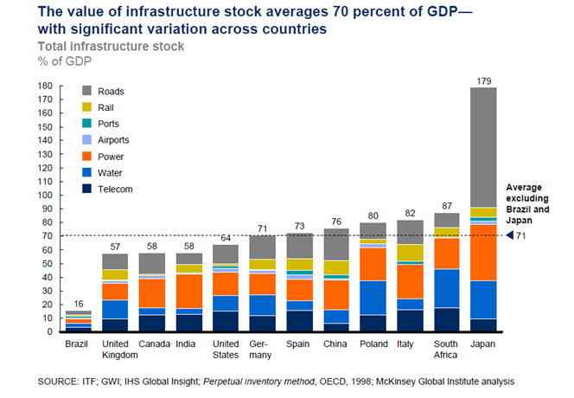
Value of the stock of infrastructure to GDP of different countries (depreciated value)
France, with a value of 75% of GDP, ranks in the middle of countries ranging from 57% for the UK to 87% for South Africa

Slide 8
GDP growth and growth in the value of the stock of infrastructure: a direct link
Underinvestment or lack of maintenance means:
risk of impairment
progressive inadequate services for which the infrastructure was designed
disruption of the local or national economy
risk to users
Let deteriorate the intrinsic quality of the heritage returns to :
depreciate gradually heritage value, since can no longer provide the expected services
take the risk of not being able to repair it if its use was impossible

Slide 9
Maintenance:
an investment
for the future
2

Slide 10
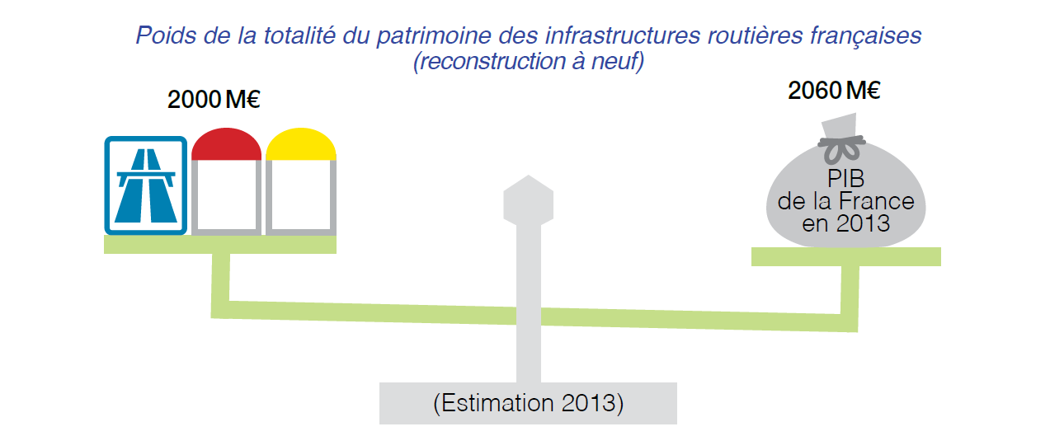
Estimated Value (reconstruction) of French heritage : 2000 billion, almost the equivalent of the annual GDP

Slide 11
4 Imperatives
for POLITICAL DECISION
3

Slide 12
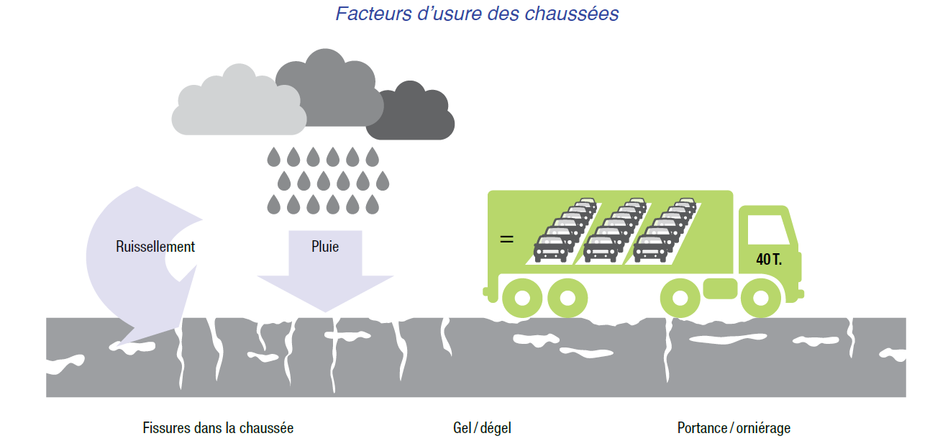
1|Know infrastructure assets
Diagnose the state of the networks
Identify the main causes of aging infrastructure and measure their impact on the cost of maintenance:
water in all its forms (freezing, thawing) and heavy vehicle traffic

Slide 13
2|Determine the value of infrastructure assets
Several approaches exist:
- replacement cost used by the French State
- the method prescribed by public accounting of local authorities taking into account the partial elements, without damping
- other proposals used to parallel GDP and value of infrastructure stock.
The study GEPUR will propose an evaluation model

Slide 14
3|Prioritize service levels and optimize maintenance techniques
Adapt current maintenance activities to each category, optimize by affecting preferentially where the economic impact is the greatest.
Find the optimum trying to take into account both the costs and the service rendered immediately, without forgetting and jeopardize long-term economic model.

Slide 15
4|Choose the best contractual relationship during the construction phase
1) Contracts with program agreed in advance in a multi-year plan
2) The performance of contracts, an average of 5 to 10 years on all or part of the network
3) Global contracts "design, construction, operation, maintenance“
4) Public-private partnerships.
whatever the solution, it is absolutely necessary to have the quantity and quality of the assets, and prioritization of the network.
=> a programming work to optimize the infrastructure life

Slide 16
4
A MAJOR
POLICY ISSUE

Slide 17
Transportation: 3rd concern of French after the safety and quality of housing
Guarantee the fundamental right of all citizens to move freely, even in the most remote areas and less dense: move in conditions of comfort, fluidity and security, regardless of the mode
=> A political challenge and an imperative to act
Policy makers pay attention to transportation infrastructure too often based on new -related accidents or weather events

Slide 18
4 KEY MESSAGES
FOR PUBLIC POLICY MAKERS
5

Slide 19
CONCLUSION
  Transport infrastructures are a public property
  Transport infrastructures are the backbone of the economy
  Preserving a heritage that is worth more than 2000 billion
  Maintaining infrastructure is an "investment" for the future

